Slide 2
The Icelandic Housing System
Guðmundur Sigfinnsson
Economist

Slide 3
The Housing Financing Fund – new role 2016
The Housing Financing Fund (HFF) is an independent government institution with a new role followed by an amended legislation.
HFF is now the institution responsible for implementation of housing policies instead of being primary a loan fund.

Slide 4
1999
2004
2011
2013
2016
65% LTV
70% LTV first time buyers
20-25% additional loan for low-income &low-equity buyers (up to 90%)
Credit-evaluation
Banks financed part of the downpayment, maximum 30-35%
The Housing Financing Fund was founded in 1999
90% LTV for all in december
Loan for a moderate apartment
Loan for one apartment
HFF bonds were issued replacing housing bonds to increase the possibility for individuals to acquire or rent housing on manageable terms.
Banks offered loans 90-100% LTV
The credit ratings of the banks increased with more housing loans in their portfolio.
In april 2004 the banks issue an appeal to the EFTA court saying HFF distort normal competition on the housing market and it‘s role should be limited to social role.
80% LTV
ESA judgement
HFF can no longer offer loans to contractors
Loans are limited to a certain max purchase price that includes smaller and medium-sized flats in the capital and most flats in rural areas
Maximum asset price that can be financed at HFF is 40 million ISK
Maximum loan amount is 24 million ISK.
Loans to rental companies are limited to non-profit companies
Loans are limited on basis of market failure
80% LTV
Consumer Credit Act in november
Obligation to inform the consumer
Total cost of the credit is calculated
Annual percentage of rate of charge
Payment scheme calculated and confirmed by the consumer
No bond issue since january 2012
Prepayments allocated to new loans
4,2% interest rates based on the last issue
State guarantee no longer granted for the bond issue
80% LTV
New role
Policy making and planning
Grants initial contributions to non-profit companies with long term goal to:
Own, lease, operate non-profit housing association.
Planned future role :
Similar arrangement as Husbanken in Norway and ARA in Finland.

Slide 5
HFF‘s future role is
Provide mortgage loans to individuals, municipalities, companies and organizations to finance housing purchase and construction work, limited to social role. (Act 44/1998, the Housing, cf. Amendment by Law 84/2012).
To be responsible for establishing a new system granting government contributions (initial contribution) to non-profit organizations to build new rental homes for the public, limited to social role and income. Prioritized to the municipalities where shortage of rental housing is the most. (Law no. 52/2016, the general apartments).
To support housing policy making and cooperate with local authorities in creating regional housing policy planning. To monitor housing needs and local planning (Law 44/1998, on Housing).
To analyze and raise awareness of the housing market, to support decision making of individuals, local authorities and government in the housing market, to promote stability and support government housing policy making (Law 44/1998, the Housing Act no. 52/2016, the general apartments).
To carry out payment of housing benefits* and monitor the development of leasing market in cooperation with local authorities (Law on housing allowances no. 75/2016 and rental housing no. 36/1994)
The role is shifting from focus on granting mortgages to be the institution responsible for the implementation of housing policies.
Notes:
Future role:
Mortgage loans limited to a social role
Responsible for establishing a new system granting government contributions (initial contribution)
Support housing policy making and monitor housing needs and local planning
Analyse and raise awareness of the housing market
Carry out payment of housing benefits* (from January 2018)
Our role is shifting from the focus on granting mortgages to be the institution responsible for the implementation of housing policies.

Slide 6
The Icelandic housing financing market
Rental market
Housing loan market
Financially independent
Active Market
Private leasing companies
Active Market; bank loans and Pension Fund loans
First time Property
Added pension Fund Savings to lower the principal of home loan
State support
Rental homes
Refundable initial contribution – based on Act on General Apartments
Loans with subsidized interests f.ex. towards rental homes to municipalities, nursing homes etc.
HFF‘s loans – Limited to social role
First property – home equity savings
Added pension fund savings to lower the principal of home loan
Housing Allowances
In need of social support
Notes:
Mapping the Icelandic house financing market

Slide 7
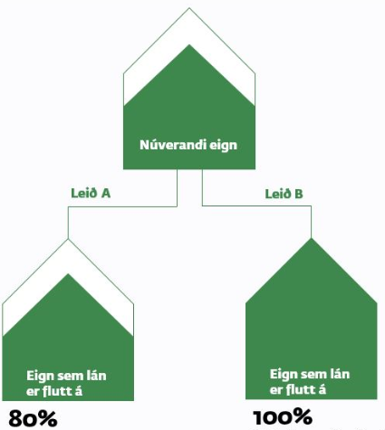
HFF‘s loans – new loans, aquisition and loan transfer
New loans
Up to 80% LTV
4,2% interest rate
Loan period 15-35 years
Annuity
Indexed CPI
Aquisitions
Up to 100% LTV
Loans that are already
Mortgaged on the property
Suitable for first time buyers
that have no savings or equity
Loan transfer
80% LTV
Up to 100% LTV in special cases:
-Moving between areas of word
-Moving to a smaller flat

Slide 8
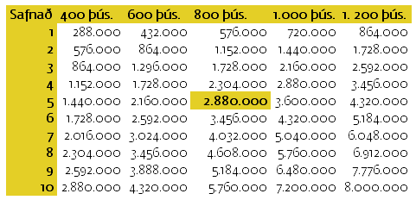
First time property - Pension Fund Savings
Working individuals can choose tax-free added pension fund savings to save up for the down payment of a property
Couple can save up to 8 million ISK over a ten year period
This is a government measure that was introduced in 2016
A couple with 800 th.kr. monthly income can save up to 2,9 m.kr. in five years

Slide 9
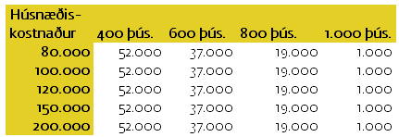
Housing allowances
Monthly tax-free allowances/housing support aimed to assist tenants and home owners
Calculations based on
Family size
Monthly income
Equity
Housing allowances - special support
Municipalities handle the applications.
Specific housing support for families and individuals who are not otherwise able to acquire their own homes due to low wages, heavy finance burdens and social conditions
Housing allowances for family size of 4 og more
In this example there is
no equity and 200 thousand monthly housing cost is 37 thousand ISK.
If this family is a home owner they can own 6 billion ISK before the allowances reduce

Slide 10
Affordable rental homes

Slide 11
Sustainable rental system
Based on the Danish legislation – general apartments /almene boliger
-Non-profit organization
-Municipality
Owns and runs long-term rental homes
Non-profit
Tax-free
Repayments of loans- max 50 years
Repayments of initial contributions
50% of profit
Housing Financing Fund
Housing Affairs Fund
Initial
contributions
Repayments of initial contributions and 50% of profit form a foundation to finance more flats with initial contributions in the rental system.
Notes:
In June 2016 we got a new legal framework for new rental housing system based on laws of general apartments and is based on the Danish model - we call apartments financed system rental homes.
The Act was to form a new company - housing foundation as the framework for the operation of rental homes. Housing Authority enjoys tax freedom and non-profit - ergo community-minded landlords. Not paid out dividends from the company and the funds collected within their resources to further build rental homes.
State and local governments to provide funds for the development of rental Homes that have capital equivalent to non-profit housing. Housing the Foundation really needs only to finance 70% of the apartments at the beginning and pay such loans to a maximum of 50 years. After the loans are payed receive refunds of foundation contributions state and local governments.
After repayment of loans, and contributions will be 50% of profits arising in housing foundation are sliding in Housing Fund and will be the basis for further allocations strain contributions and constructive analyzes rental homes.
Organizations that pay the Housing Fund Priority will be given to 60% of the money paid into the fund. Thus, for a time, sustainable rental housing system.
With this arrangement, which is analogous to customary in Denmark for decades, will gradually build up a new fund called the Housing Fund which aims to promote the sustainability of the system. Such a system is not to actually happen until several decades after the loans taken in the next few years have been paid up.

Slide 12
Object
Improve housing security of low-income families and individuals by increasing access to secure and appropriate residential housing for rent.
Notes:
Act is based on a statement the government announced in May 2015 which discusses the increase in cost-effective and low-cost housing to ensure low-income families long term rents, emphasis will be placed on the flats of moderate size.
The legislation aims to:
Improve housing security of low-income families and individuals and youth by increasing access to safe and appropriate residential for rent.
It is also to contribute to the cost of housing conforms to the payment of the tenant.
To achieve the goal with a special focus on new construction and increasing the number of rental properties.

Slide 13
Special emphasis
New homes and an increase in the number of rental apartments.
Apartments in areas where there is a need for rental apartments for tenants who are under income and asset limits.
Notes:
The legislation aims to:
Improve housing security of low-income families and individuals and youth by increasing access to safe and appropriate residential for rent.
It is also to contribute to the cost of housing conforms to the payment of the tenant.
To achieve the goal with a special focus on new construction and increasing the number of rental properties.

Slide 14
In addition, emphasis is placed on
Efficient methods of apartment construction for the purpose of reducing construction costs.
Creative and innovative solutions and good design.
Apartments that fulfil the needs of the residents in each area.
Apartments that fulfil the needs of different groups.
Encouraging diversity in the composition of residents and the mixing of socio-economic classes.
Notes:
Act is based, among other things the government announced on 28 May 2015 which, inter alia, discusses the increase in cost-effective and low-cost housing to ensure low-income families rented long term, emphasis will be placed on the flats of moderate size.
The legislation aims to:
improve housing security of low-income families and individuals and youth by increasing access to safe and appropriate residential for rent.
It is also to contribute to the cost of housing conforms to the payment of the tenant.
To achieve the goal with a special focus on new construction and increasing the number of rental properties.

Slide 15
Prioritization => competition in affordable housing
The Housing Financing Fund advertises the amount to be allocated for initial contributions twice a year
Excess demand for the contribution
Leads to prioritizing of application on basis of the emphasis on new builds, need for rental apartments, affordability & encouraging diversity.
Notes:
Act is based, among other things the government announced on 28 May 2015 which, inter alia, discusses the increase in cost-effective and low-cost housing to ensure low-income families rented long term, emphasis will be placed on the flats of moderate size.
The legislation aims to:
improve housing security of low-income families and individuals and youth by increasing access to safe and appropriate residential for rent.
It is also to contribute to the cost of housing conforms to the payment of the tenant.
To achieve the goal with a special focus on new construction and increasing the number of rental properties.

Slide 16
Focus group
Income group
Promote affordable rental homes for:
Students
Young people
Elderly
Disabled
People who cannot afford housing because of social or financial problems.
5
4
3
Tax payers – 22%
144.000 tax-homes over 25 years
31.000 tax-homes over 25 years
2
Income and asset limit
Individual 396.000 ISK pr. month
Individual w. 4 child. 791.000
Couple 554.000
Couple w.4 child 950.000
For each child 99.000
Asset limit 5.126.000
1
Notes:
The initial law intended tenants in the two lowest income quintile and will be applicable to a diverse group of people

Slide 17
Initial contributions
A powerful new instrument for the promotion of rental homes that are long-term options on the rental market
18%
State contribution
18% basic contribution
Additional contribution
6% market failure
4% students/disabled
State
18-28%
6%
4%
Municipalities
12-16%
12%
Municipalities
12% basic contribution
4% market failure
4%
56-70%
Another finance
Loan
Equity
Notes:
The state contribution can amount to 18% of the purchase price of the apartment and can take the form of direct inputs or interest subsidy. If the initial contribution is in the form of direct contributions paid out in two installments upon approval first and then to a rented apartment. ?? The state's contribution is in the form of equity and local contributions may take the form of the allocation of plots and abolishment of tariffs. One of the conditions for the granting of endowment capital is that the applicant has already received an initial contribution approved by the municipality where the apartment is located apply.
Additional contributions for state and local governments can be 10% combined on the basis of market failure, 6% from the state and 4% from the municipality.
The state also provides an additional 4% contributions to students and the disabled.

Slide 18
Government aim to build 2.300 rental flats next four years
2.300
Rental flats
2016-2019
509
124
600
600
600
600
00
385
2.300
Housing plans
Notes:
The government has set targets for the development of 2,300 new rental homes in the next four years with the Act.
In parallel with this project the HFF (in collaboration with the Icelandic Association of Local Authorities) are helping the local governments with detailed housing plans decision on the further development of the system will in future take account of them.
We call for an immediate application in September dismissing the 2016 strain contributions to 385 new rental apartments in the first allocation at year-end and 123 in the second allocation.
Our goal is to reach the building the most cost apartments for the resources that we are proposed.

Slide 19
Initial contributions 2016 – 509 rental flats
8 North-west of Iceland
8 Skagafjörður
5 North east of Iceland
5 Akureyri – Brynja hússjóður
11 Westfjords
11 Ísafjarðarbær
451 Capital area
1 í Mosfellsbæ - Brynja
3 í Hafnarfirði - Brynja
32 í Hafnarfirði - Bjarg
115 í Reykjavík - Bjarg
83 í Reykjavík – Félagsbústaðir
112 í Reykjavík – Nauthólsvegur 83 hses.
4 í Hafnarfirði - FS
33 í Kópavogi - FS
4 í Kópavogi - fatlaðir
63 í Reykjavík – Bjarg
1 í Reykjavík - Brynja
3 The West of Iceland
3 Akranesi – Brynja Hússjóður
22 South of Iceland
11 í Vestmannaeyjum FS
4 í Vík í Mýrdal
5 í Höfn í Hornafirði
2 í Árborg – Brynja hússjóður
9 The Southern Peninsula
4 í Reykjanesbæ Brynja
5 í Sandgerði Þroskahjálp

Slide 20
Five forces lead to affordable rent
Initial contribution
Initial funding of 30-44% of building cost
The aim is that the rent will not exceed higher portion of income than
25%
Affordable design
For the purpose of reducing construction costs
No taxes paid
The non-profit companies (new type of company form) that have obligations according to the Act on General Apartments don‘t pay taxes
Demands in building regulation
Pertaining to facilitate the construction of small flats and cottages
Housing allowances
Upgraded to support the rental market
Notes:
The forces that contribute to a reduction in the rent are:
- Only need to finance 56-70% of initial cost residential based with initial contributions
- The focus is on cost-effective design in order to reduce construction costs.
- Independent Housing is tax freedom
- The requirements of the building regulations pertaining to facilitate the construction of small apartments and chalets
- housing have been upgraded to support rent. - effective 1 January 2017. (Increase housing benefits from 22 thousand to 31-54 thousand.)

Slide 21
Market failure
10% additional contributions can be
granted in case of market failure
6% from the state
4% from the municipalities
60%
Other finance
Initial contributions
40%
18% + 6% initial contribution from the state
12% + 4% initial contribution from the municipalities
Notes:
In areas where market failure exists and general lease is low people ask themselves - how to bridge the gap between market rents and low rent to cover construction costs.
In areas where there is market failure can initial contribution of state and local reach 40%. That means you only need to finance 60% of the stock value of the building at the beginning.

Slide 22
Market failure
Initial contribution granted
Repayments of initial contributions
24%
18%
The State
40%
of building costs
34%
of official property registration (lower than building costs outside the capital area)
Municipalities
16%
16%
60%
The municipalities will decide
if they demand repayments of the initial contributions
Notes:
Where there is market failure candidates can get 40% of the building cost in loan grants
When loans have been repaid and the repayment Anna initial contribution of refund due to 34% of the property value of a property.
Additional Contributions state granted because of market failure are not recoverable. The state will require repayment of 18% initial contribution and its local governments decide individually whether they will demand a refund of their contributions strain.

Slide 23
How do we evaluate if building is cost-effective
How can we maximise the number of flats we build for the initial contributions?

Slide 24
Evaluation of cost-effectiveness
Flat size
Plots/sites and plots prices
Maximum building cost
Underground parking
Affordable design and well utilized square meters
Creative and ingenous design
Affordable building methods
Building time
As cost-effective as conditions permit in order to be able to rent them on
reasonable terms
Notes:
Competition for funding proposed in the initial contributions
There is competition for the resources that the State proposes to loan grants. When applying for higher amounts than advertised comes to priorities between applications, is based on the preferences of the law are: the need for construction in the municipality, new construction in excess of the purchase, affordable apartment, Social Integration, a business that goes for both the company and the business that promotes the rental price is less than 25% of income and need group. The focus of the new buildings and buildings where the need is most accounted for most of the estimates.
Evaluation of efficiency
It is not recommended for one state leader in the design or practicality of the law but is evaluated each application based on several factors. We HFF enjoyed the benefits of having acquired and sold a lot of assets. We have employed both real estate agents and building designers who have tremendous knowledge of property markets, both in the situation and will be assessed properties in the whole country. We also based on data from the National Registry where we have an overview all registered purchase agreements in the country. For your reference, we have also Hannarr key buildings. Given on the evaluation of the feasibility of any application based on lagaáherslunni the apartments are as cost-effective as conditions permit in order to be able to rent them at reasonable terms.
When it comes to assessing the feasibility are several factors that are of primary importance:
size
Land and land prices
maximum Building costs
Car cellars
Design and infrastructures
Creative and ingenious solutions
cost-effective methods
construction time

Slide 25
Flat size
Netto m²
The portion of netto (excluding the common area), and brutto (plus common area) m² as low as can be.
Notes:
size:
The first focus is on apartments are of modest size. Because HFF has set for the new housing sizes by number. It is important that the apartments are of modest size, it is possible to rent them at reasonable terms. Size on published meter.
While the focus is on new construction, we have also set ourselves reference amounts for purchased flats than it is possible to apply for purchases in the market and would purchase on a purpose built flat shoes than purchase of existing buildings would not be such a high priority in processing because of its focus on building .
Regarding sizes older residential those tickets to that of the property market is at least 25% below the limits we have set.
The size and exercise are also important parameters in the feasibility assessment. We want that the proportion of published and built-up square is the least that is to the few square meters are in addition to the corridors and common spaces.
- - - - - - - - - - - - - - - - - - - - - - - - - - - - - - - - - - - - - - - - - - - - - -
Universal design: know what it is and we looked at a number of designs that tells us to 60m2 2 bedroom apartment to fail to meet the requirements of universal design - is all about efficiency design.
- - - - - - - - - - - - - - - - - - - - - - - - - - - - - - - - - - - - - - - - - - - - - -
Displays square meters are just flat and storage
Built square meters are all built square meters and in addition to the display meter added to the hallways and spaces sameignleg
All apartments in the apartment building built after the millennium has a ratio of 1.16. We detected ratio are quite down to 1.1 and raise up to 1.2

Slide 26
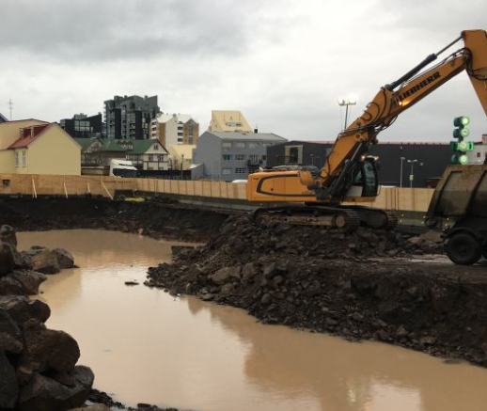
Plots/sites and plot prices
Sufficient supply of plots to build small apartments
Incentives to build small flats
Plot prices have to support the affordability of the apartments
Notes:
Land and land prices
It is important to obtain a supply of land to build apartments in the classes of this size.
There has been much talk about the shortage of small apartments efficient despite the call there. An examination in land prices may be seeing a lot of plot costs are fixed costs compared to the peak in construction. Such an arrangement on tariff municipalities can act as a catalyst for a builder to build maximum example larger apartments. It is important that the files will contain incentives to build smaller apartments to achieve the objectives of the government for the construction of rental homes.
Plots can be mishagkvæmar - Land needed to strike down the steel deck of the sea or the presence of buildings, land on the rock needed to blow etc. We encourage local course to submit the project to the land sites with the most economical.
Land prices is of course one of the factors looked at when assessing feasibility. High land prices can lead to a business plan assumptions and criteria for the rent break and efficiency is not considered achieved.

Slide 27
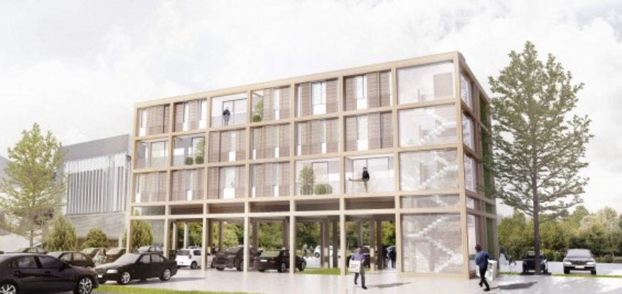
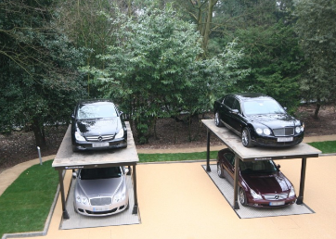
Underground parking
Not excluded in the Act of General Apartments
Underground parking can increase the cost of flats by 2-6 m.ISK.
Therefore decrease the affordability of the apartments
Affordable underground parking or car park can be feasible
Notes:
Car cellars
Although there is a ban on parking in the underground garage of the Act (and in fact expressly stated in the Act that the maximum construction is outside the cost of parking / bílgeymslur) is difficult to build apartments that are considered cost-effective, and less than the maximum construction if we each apartment inserted 2-6 million cost of the underground garage, classified as such buildings usually as a luxury addition to the apartment.
But the garage is not the same as underground parking. Underground parking is under apartment must meet the requirements for fire protection, must have ventilation equipment, heating and electric opening is very expensive. Underground parking near the sea needed to be waterproof is also very expensive. Open car park, however, are cheaper to half the initial cost and their operations are far cheaper.
- - - - - - - - - - - - - - - - - - - - - - - - - - - - - - - - - - - - - - - - - - - - - -
Open / closed
With ventilation equipment
Heating and electric opening
Description

Slide 28
Maximum building cost
Maximum building cost
Brutto m² plus common area
Initial contribution is a percentage of the apartment cost plus plot prices
5 million ISK+
220 þús. pr. m²
Plot prices
Notes:
The maximum construction cost of each apartment is determined in regulation and his 5 million per apartment and 220 thousand per square meter that is built. This is actually the IKEA way to design the first asking price and all versions of the building must be guided by him.
Powder value of the cost of the apartment is ready for rental and then added to the lot cost and gatnagerðargjöld as they are in each municipality.
We expect initial contributions as a percentage of the stock value of apartments.
- - - - - - - - - - - - - - - - - - - - - - - - - - - - - - - - - - - - - - - - - - - - - -
Powder value = Cost = Construction costs + plot cost + gatnagerðargjöld + port charges + cost of utilities and other public charges + Design cost + capital costs during construction + cost of final inspection - refundable VAT + costs incurred developer of monitoring, office accounting and supervision under. defined proportions in Article 11. Regulation. 555/2016

Slide 29
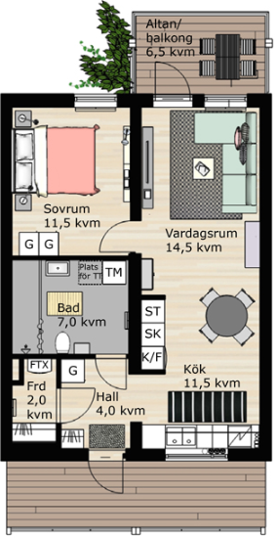
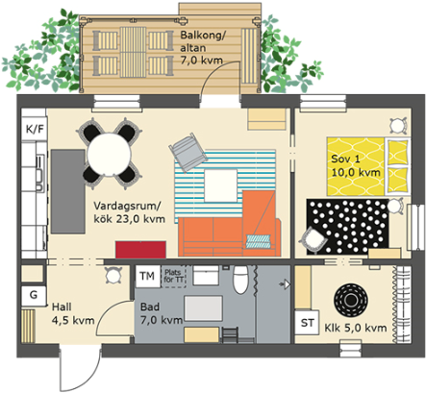
Affordable design
50,5 m2
Simple design
Well utilized square meters
Well organized pipe routes
Suitable for user group
BoKlok - teikningar
Notes:
Design and infrastructures
Good design => simple design is part of bringing down construction costs. Good organization and square used well
Good infrastructures, for example, not spend unnecessary space to walk.
Simple pipe routes are also a factor that we look at what they contribute to increased efficiency apartment.
Simple structure - to increase sveigjanleiika building and increase the ability to deal with any required size dwellings - space that can expanded / narrowed internally between residential
How well suited to design a user group that the facility is designed.
Municipalities can, for example, teamed up for the design of efficient apartments which can be based on more sites.

Slide 30
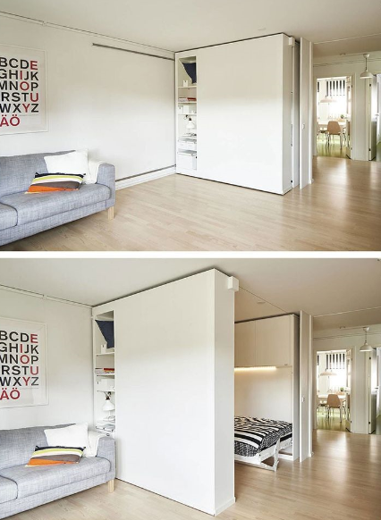
Creative and ingenous design
Notes:
Creative and ingenious solutions to achieve good design.
Lots of good ideas. Reykjavík City will hold question survey to identify the needs of tenants. Flat rock club will hold a design contest due to build rental homes.
We have seen progress in the design of residential students (Icelandic Student) that are for example with movable walls such that spaces can vary in size.
That is not to say that although the apartment is small, the Nun useful not well.
Good ideas will get a high station in the system and we have confidence that they will wrap themselves.

Slide 31
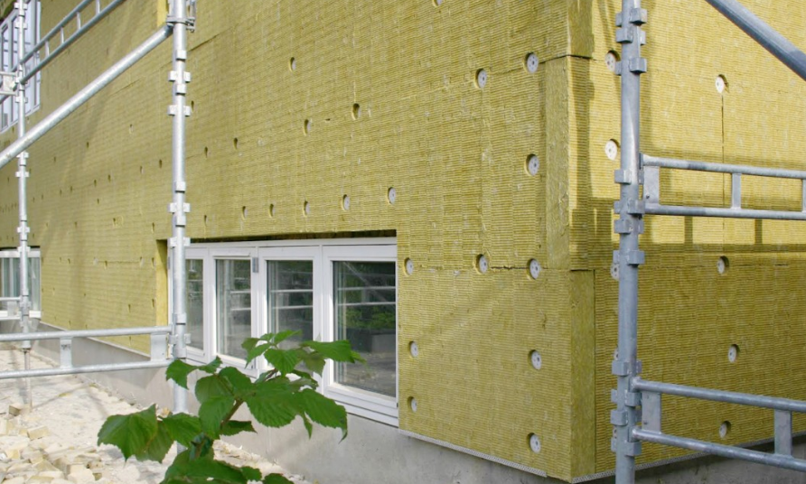
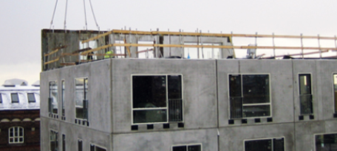
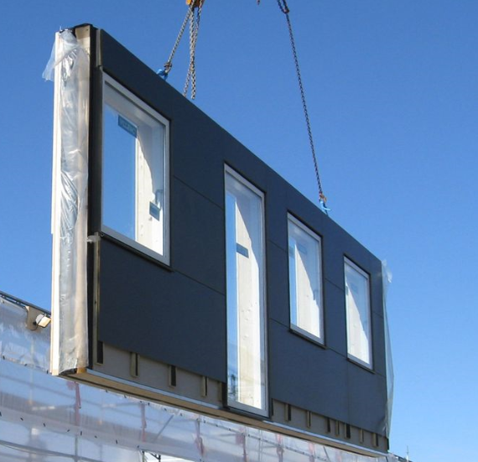
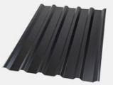
Building material
Affordable and durable
Series- units
Notes:
building materials
We assess that used to be cost-effective construction methods in order to reduce construction costs. e.g. the building that they are affordable and durable. If they are not durable maintenance costs will drag down the business plan for the future.
Series-units;
Precast units,
factory produced timber unit may be a viable option.
If the building is well planned in advance are fewer uncertainties more likely to achieve efficiency.
Series-solutions have been gaining market share in the Nordic region and a short construction period, are cost-effective, standardized and have a little uncertainty in the project. In the economic situation is now today where many projects competing for employees in the construction industry can be series-solutions a good choice for the housing market today.
It will be interesting to hear more about the possibility that they consist of presentations that are held below.

Slide 32
Construction time
Prioritize the projects that are likely to be fully finished as soon as possible.
Shorter construction time reduces the overall cost of capital and rental prices for consumers.
The ratio of cost of capital of the total construction cost
6 month
12 month
18 month
24 month
3%
5%
8%
12%
Notes:
construction time
If we can not accept all applications, the construction time also important. We process the first apartments that are likely to be fully finished as soon as possible. The shorter the construction time, the lower the total capital costs of the project and as a result, rental rates.
Asgeir Torfason lecturer in HR was a lecture on real estate conference in which he took the example of Sweden, where the real estate company he worked in construction reached down from 18 months to nine and was a substantial reduction in financing costs during the construction of accomplishment.
Conclusion:
We believe that the arrangement will spells out good things
This is a competition for resources as I mentioned at the beginning - the competition for good ideas
Good ideas will be reused and will get wind of the system.
The funds will pursue cost efficiency

Slide 33
Thank you

